Slide 1

Computer Security
Slides Source
(Courtesy of Prof Matt Bishop and several websites)
Lecture # 2
Asad Raza
asadraza@mcs.edu.pk
Slide #1-<number>

Slide 2
Chapter 2: Confidentiality Policies
Overview
  What is a confidentiality model
Bell-LaPadula Model
  General idea
  Informal description of rules
Slide #5-<number>

Slide 3
Confidentiality Policy
Goal: prevent the unauthorized disclosure of information
  Deals with information flow
  Integrity incidental
Multi-level security models are best-known examples
  Bell-LaPadula Model basis for many, or most, of these
Slide #5-<number>

Slide 4
Bell-LaPadula Model, Step 1
Security levels arranged in linear ordering
  Top Secret: highest
  Secret
  Confidential
  Unclassified: lowest
Subjects have security clearance L(s)
  Objects have security classification L(o)
Slide #5-<number>

Slide 5
Example
security level | subject | object
Top Secret | Tamara | Personnel Files
Secret | Samuel | E-Mail Files
Confidential | Claire | Activity Logs
Unclassified | Ulaley | Telephone Lists
Tamara can read all files
Claire cannot read Personnel or E-Mail Files
Ulaley can only read Telephone Lists
Slide #5-<number>

Slide 6
Reading Information
Information flows up, not down
  “Reads up” disallowed, “reads down” allowed
Simple Security Condition (Step 1)
  Subject s can read object o iff L(o) ≤ L(s) and s has permission to read o
    Note: combines mandatory control (relationship of security levels) and discretionary control (the required permission)
  Sometimes called “no reads up” rule
Slide #5-<number>

Slide 7
Writing Information
Information flows up, not down
  “Writes up” allowed, “writes down” disallowed
*-Property (Step 1)
  Subject s can write object o iff L(s) ≤ L(o) and s has permission to write o
    Note: combines mandatory control (relationship of security levels) and discretionary control (the required permission)
  Sometimes called “no writes down” rule
Slide #5-<number>

Slide 8
Basic Security Theorem, Step 1
If a system is initially in a secure state, and every transition of the system satisfies the simple security condition, step 1, and the *-property, step 1, then every state of the system is secure
Slide #5-<number>

Slide 9
Bell-LaPadula Model, Step 2
Expand notion of security level to include categories
Security level is (clearance, category set)
Examples
  ( Top Secret, { NUC, EUR, ASI } )
  ( Confidential, { EUR, ASI } )
  ( Secret, { NUC, ASI } )
Slide #5-<number>

Slide 10
Levels and Lattices
Security level (L, C) dom security level(L′, C′) iff L′ ≤ L and C′ ⊆ C
Examples
  (Top Secret, {NUC, ASI}) dom (Secret, {NUC})
  (Secret, {NUC, EUR}) dom (Confidential,{NUC, EUR})
  (Top Secret, {NUC}) ¬dom (Confidential, {EUR})
Slide #5-<number>

Slide 11
Problem
Colonel has (Secret, {NUC, EUR}) clearance
Major has (Secret, {EUR}) clearance
  Major can talk to colonel (“write up” or “read down”)
  Colonel cannot talk to major (“read up” or “write down”)
Clearly absurd!
Slide #5-<number>

Slide 12
Solution
Define maximum, current levels for subjects
  maxlevel(s) dom curlevel(s)
Example
  Treat Major as an object (Colonel is writing to him/her)
  Colonel has maxlevel (Secret, { NUC, EUR })
  Colonel sets curlevel to (Secret, { EUR })
  Now maxlevel(colonel) dom curlevel(Colonel)
    Colonel can write to Major without violating “no writes down”
Slide #5-<number>

Slide 13
DG/UX System
Provides mandatory access controls
  MAC label identifies security level
  Default labels, but can define others
Initially
  Subjects assigned MAC label of parent
    Initial label assigned to user, kept in Authorization and Authentication database
  Object assigned label at creation
    Explicit labels stored as part of attributes
    Implicit labels determined from parent directory
Slide #5-<number>

Slide 14
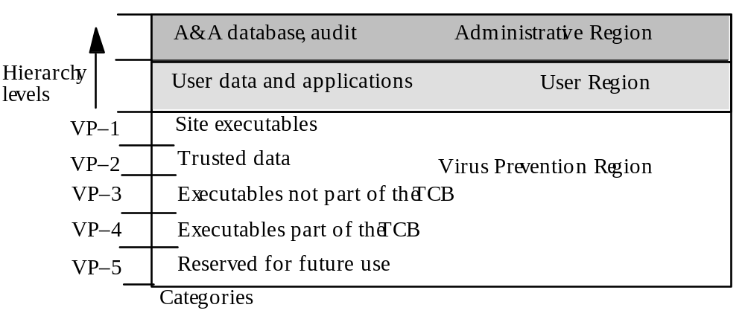
MAC Regions
Slide #5-<number>

Slide 15
Directory Problem
Process p at MAC_A tries to create file /tmp/x
/tmp/x exists but has MAC label MAC_B
  Assume MAC_B dom MAC_A
Create fails
  Now p knows a file named x with a higher label exists
Fix: only programs with same MAC label as directory can create files in the directory
Slide #5-<number>

Slide 16
Multilevel Directory
Directory with a set of subdirectories, one per label
  These hidden directories are Not normally visible to user
  p creating /tmp/x actually creates /tmp/d/x where d is directory corresponding to MAC_A
  All p’s references to /tmp go to /tmp/d
p cd’s to /tmp/a, then to ..
  System call stat(“.”, &buf) returns different inode number for each process
  System call dg_mstat(“.”, &buf) returns inode of /tmp
Slide #5-<number>

Slide 17
Object Labels
Requirement: every file system object must have MAC label
Roots of file systems have explicit MAC labels
  If mounted file system has no label, it gets label of mount point
Object with implicit MAC label inherits label of parent
Slide #5-<number>

Slide 18
Object Labels
Problem: object has two names
  /x/y/z, /a/b/c refer to same object
  y has explicit label IMPL_HI
  b has explicit label IMPL_B
Case 1: hard link created while file system on DG/UX system, so …
Creating hard link requires explicit label
  If it doesn’t then implicit is converted to explicit
  Moving a file makes label explicit
Slide #5-<number>

Slide 19
Object Labels
Case 2: hard link exists when file system mounted
  No objects on paths have explicit labels: paths have same implicit labels
  An object on path acquires an explicit label: implicit label of child must be preserved
so …
Change to directory label makes child labels explicit before the change
Slide #5-<number>

Slide 20
Object Labels
Symbolic links are files, and treated as such, so …
When resolving symbolic link, label of object is actually label of target of the link
  System needs access to the symbolic link itself
Slide #5-<number>

Slide 21
Using MAC Labels
DG/UX uses Bell-Lapadula with one change
Simple security condition implemented
*-property not fully implemented
  Process MAC must equal object MAC
  Writing allowed only in same security compartment
Overly restrictive in practice
Slide #5-<number>

Slide 22
MAC Tuples
Up to 3 MAC ranges (one per region)
MAC range is a set of labels with upper, lower bound
  Upper bound must dominate lower bound of range
Examples
  [(Secret, {NUC}), (Top Secret, {NUC})]
  [(Secret, ∅), (Top Secret, {NUC, EUR, ASI})]
  [(Confidential, {ASI}), (Secret, {NUC, ASI})]
Slide #5-<number>

Slide 23
MAC Ranges
[(Secret, {NUC}), (Top Secret, {NUC})]
[(Secret, ∅), (Top Secret, {NUC, EUR, ASI})]
[(Confidential, {ASI}), (Secret, {NUC, ASI})]
(Top Secret, {NUC}) in ranges 1, 2
(Secret, {NUC, ASI}) in ranges 2, 3
[(Secret, {ASI}), (Top Secret, {EUR})] not valid range
  as (Top Secret, {EUR}) ¬dom (Secret, {ASI})
Slide #5-<number>

Slide 24
Objects and Tuples
Objects must have MAC tuples and labels
  May also have MAC label
  If both, tuple overrides label
Example
  Paper has MAC range:
  [(Secret, {EUR}), (Top Secret, {NUC, EUR})]
Slide #5-<number>

Slide 25
MAC Tuples
Process can read object when:
  Object MAC range (lr, hr); process MAC label pl
  pl dom hr
    Process MAC label grants read access to upper bound of range
Example
  Peter, with label (Secret, {EUR}), cannot read paper
    (Top Secret, {NUC, EUR}) dom (Secret, {EUR})
  Paul, with label (Top Secret, {NUC, EUR, ASI}) can read paper
    (Top Secret, {NUC, EUR, ASI}) dom (Top Secret, {NUC, EUR})
Slide #5-<number>

Slide 26
MAC Tuples
Process can write object when:
  Object MAC range (lr, hr); process MAC label pl
  pl ∈ (lr, hr)
    Process MAC label grants write access to any label in range
Example
  Peter, with label (Secret, {EUR}), can write paper
    (Top Secret, {NUC, EUR}) dom (Secret, {EUR}) and (Secret, {EUR}) dom (Secret, {EUR})
  Paul, with label (Top Secret, {NUC, EUR, ASI}), cannot write paper
    (Top Secret, {NUC, EUR, ASI}) dom (Top Secret, {NUC, EUR})
Slide #5-<number>

Slide 27
Key Points
Confidentiality models restrict flow of information
Bell-LaPadula models multilevel security
  Cornerstone of much work in computer security
Slide #5-<number>

